Slide 1
Handling Touches
INFO 6350

Slide 2
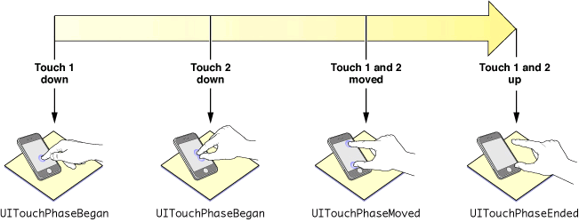
A multitouch sequence and touch phases.
Touches are represented by UITouch objects.
A touch event is represented by a UIEvent object of type UIEventTypeTouches

Slide 3
Touches have both temporal and spatial aspects.
The temporal aspect ( called a phase): indicates when a touch has just begun, whether it is moving or stationary, and when it ends—that is, when the finger is lifted from the screen.
The spatial aspect of touches concerns their association with the object in which they occur as well as their location in it.
  When a finger touches the screen, the touch is associated with the underlying window and view and maintains that association throughout the life of the event.

Slide 4
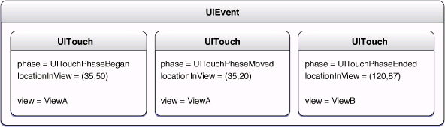
The phase of a finger touch
UITouchPhaseBegan,
UITouchPhaseMoved,
UITouchPhaseStationary,
UITouchPhaseEnded,
UITouchPhaseCancelled,

Slide 5
Handling Touch Events
Touches are handled by UIResponder objects such as UIView, UIViewController, UIImageView , UISlider, UIApplication , UIWindow
A view controller typically receives, via the responder chain, touch events initially sent to its view if that view does not override the touch-handling methods.
Must implement the following methods:
func touchesBegan(_ touches: Set<UITouch>, with event: UIEvent?)
func touchesMoved(Set<UITouch>, with: UIEvent?)
func touchesEnded(_ touches: Set<UITouch>, with event: UIEvent?)
func touchesCancelled(_ touches: Set<UITouch>, with event: UIEvent?)

Slide 6
UIEvent/UITouch
isMultipleTouchEnabled property: When set to YES, the receiver receives all touches associated with a multitouch sequence. When set to NO, the receiver receives only the first touch event in a multitouch sequence.
UIEvent object has a set of UITouch objects
To get any of the touch objects, send the Set object an anyObject message
allTouches on the event object, returns all touch objects.
window: message, returns objects in a specific window
view: returns objects in a specific View
Location(in: UIView?): UITouch method which, if passed a parameter of self, yields the location of the touch in the coordinate system of the receiving view.
previousLocation(in: UIView?): tells the previous location of the touch
tapCount a property of the UITouch instance that tells how many taps have been made
(timestamp): when the touch was created or last mutated
(phase): what phase it is in .
type: direct, indirect, stylus.
force: The force of the touch, where a value of 1.0 represents the force of an average touch.

Slide 7
- (void)touchesBegan:(NSSet *)touches withEvent:(UIEvent *)event {}
– (void)touchesMoved:(NSSet *)touches withEvent:(UIEvent *)event {}
- (void)touchesEnded:(NSSet *)touches withEvent:(UIEvent *)event {
for (UITouch *touch in touches) {
if (touch.tapCount >= 2) {
[self.superview bringSubviewToFront:self];
}
}
}
- (void)touchesCancelled:(NSSet *)touches withEvent:(UIEvent *)event {}
Detecting a double-tap gesture

Slide 8
Override sendEvent: in a custom subclass of UIWindow to forward touch events to the appropriate responders.
In the implementation you should always invoke the superclass implementation of sendEvent:.
If you handle events in a subclass of UIView, UIViewController, or (in rare cases) UIResponder,
  You should implement all of the event-handling methods (even if it is a null implementation).
  Do not call the superclass implementation of the methods.
If you handle events in a subclass of any other UIKit responder class,
  You do not have to implement all of the event-handling methods.
  In the methods you do implement, be sure to call the superclass implementation. For example,
  super.touchesBegan(theTouches, with:theEvent)

Slide 9
Gesture Recognizers
UIGestureRecognizer class defines a programmatic interface and implements the behavioral underpinnings for gesture recognition.
It simplifies the Event handling
UITapGestureRecognizer: Tapping (any number of taps)
UIPinchGestureRecognizer: Pinching in and out (for zooming a view)
UIPanGestureRecognizer: Panning or dragging
UISwipeGestureRecognizer: Swiping (in any direction)
UIRotationGestureRecognizer: Rotating (fingers moving in opposite directions)
UILongPressGestureRecognizer: Long press (also known as “touch and hold”)
UIScreenEdgePanGestureRecognizer: looks for panning (dragging) gestures that start near an edge of the screen.

Slide 10
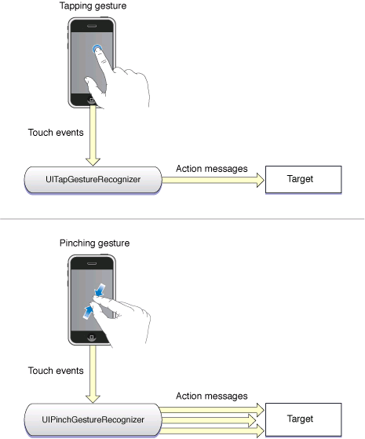

Slide 11
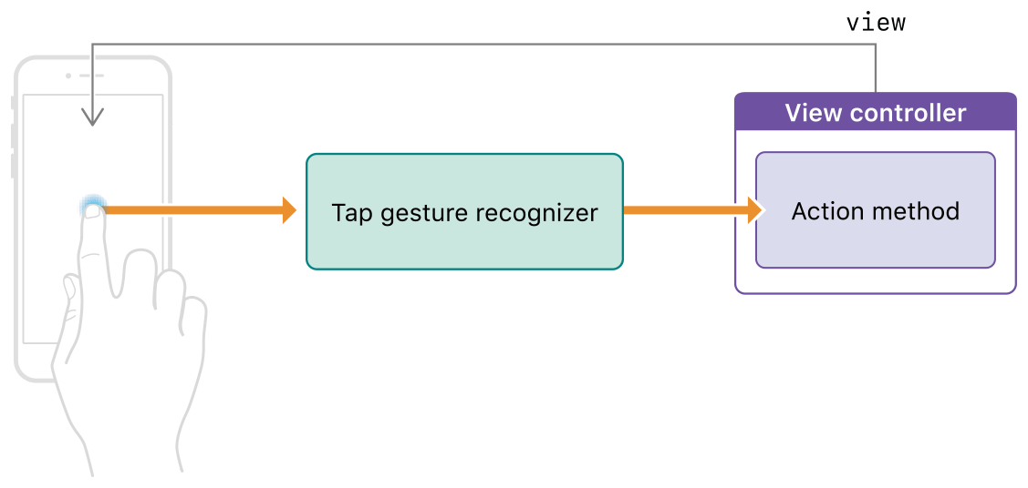
Gesture recognizer notifying its target

Slide 12
Implementing Gesture Recognition
1- Initialize
    let singleFingerDTap: UITapGestureRecognizer(target: self, action:@selector(handleDoubleDoubleTap))
    singleFingerDTap. numberOfTapsRequired = 2 //double taps
    singleFingerDTap. numberOfTouchesRequired =1 //single finger
2. Add it to the view:
    self.theView.addGestureRecognizer(singleFingerDTap)
3. Provide the implementation to handle the gesture
@IBAction func handleSingleDoubleTap:(_ gestureRecognizer : UITapGestureRecognizer) {
guard gestureRecognizer.view != nil else { return }
if gestureRecognizer.state == .ended { // Move the view down and to
//the right when tapped.
let animator = UIViewPropertyAnimator(duration: 0.2, curve: .easeInOut, animations: {
gestureRecognizer.view!.center.x += 100 gestureRecognizer.view!.center.y += 100
})
animator.startAnimation()
}}
. The view can be both the recognizer and the handler of the gesture.

Slide 13
A Pan gesture handling example
(Dragging a view around the screen)
var initialCenter = CGPoint() // The initial center point of the view
@IBAction func panPiece(_ gestureRecognizer : UIPanGestureRecognizer) {
guard gestureRecognizer.view != nil else {return}
let piece = gestureRecognizer.view! // Get the changes in the X and Y directions
// relative to the superview's coordinate space
let translation = gestureRecognizer.translation(in: piece.superview)
if gestureRecognizer.state == .began { // Save the view's original position.
self.initialCenter = piece.center
}
// Update the position for the .began, .changed, and .ended states
if gestureRecognizer.state != .cancelled { // Add the X and Y translation
// to the view's original position.
let newCenter = CGPoint(x: initialCenter.x + translation.x, y:
initialCenter.y + translation.y)
piece.center = newCenter
} else { // On cancellation, return the piece to its original
location.piece.center = initialCenter
}
}

Slide 14
@IBAction func swipeHandler(_ gestureRecognizer : UISwipeGestureRecognizer) {
if gestureRecognizer.state == .ended {
// Perform action.
}
}
// --------------- // Two fingers, two taps // ------------------let twoFingersTwoTaps = UITapGestureRecognizer(target:self, action:#selector(twoFingersTwoTaps))
twoFingersTwoTaps.numberOfTapsRequired=2
twoFingersTwoTaps.numberOfTouchesRequired=2
Self.view.addGestureRecognizer(twoFingersTwoTaps)
// ---------------- // Two finger pinch // ---------------------let twoFingerPinch = UIPinchGestureRecognizer(target:self action:#selector(twoFingerPinch))
Self.view.addGestureRecognizer(twoFingerPinch)
The isUserInteractionEnabled property of the view is set to true. Image views and labels set this property to false by default.

Slide 15
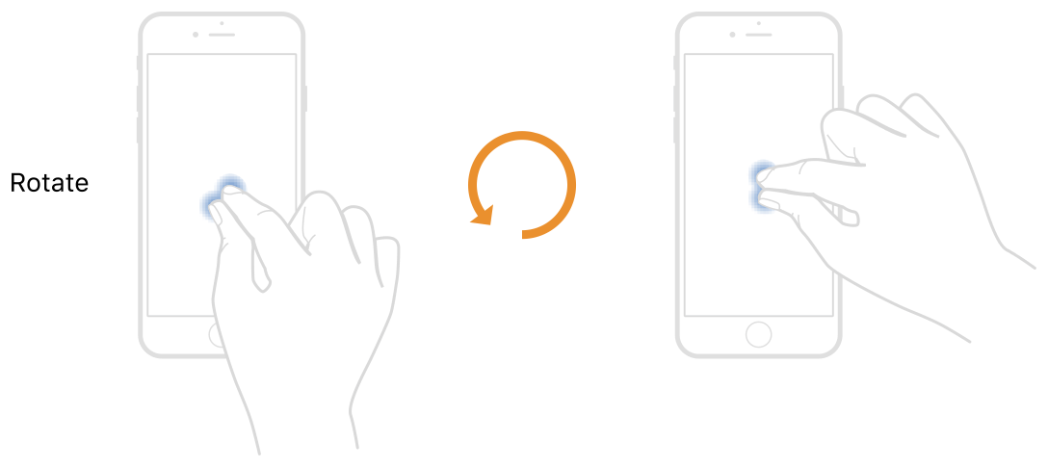
@IBAction func rotatePiece(_ gestureRecognizer : UIRotationGestureRecognizer) { // Move the anchor point of the view's
// layer to the center of the
// user's two fingers. This creates a more
// natural looking rotation.
guard gestureRecognizer.view != nil else { return }
if gestureRecognizer.state == .began || gestureRecognizer.state == .changed {
gestureRecognizer.view?.transform =
gestureRecognizer.view!.transform.rotated(by: gestureRecognizer.rotation)
gestureRecognizer.rotation = 0
}
}

